Slide 1
Data Management System
for a university

Slide 2
Introduction
01
Database Design
02
Agenda
06
Challenges Faced
SQL Queries
03
07
Q & A
05
Bash scripts
SPL/SQL scripts
04

Slide 3
01
Introduction

Slide 4
Introduction
Explore our Data Management System project, crafted to enhance educational institutions' efficiency. We've designed a robust system for streamlined student enrollment, course management, and insightful grade analysis. Throughout this presentation, we'll delve into key elements such as database design, SQL queries, PL/SQL scripts, and automation processes, including backup and monitoring. Join us as we share the challenges faced, transparently discuss solutions, and showcase the unique features of our data-driven solution.

Slide 5
02
Database Design

Slide 6
Entities
Students
Courses
Departments
Enrollment
Relationships
One-to-Many between Departments and Students
One-to-Many between Departments and Courses
Many-to-Many between Students and Courses
Attributes
Students: id , firstname , lastname , email , gender , birthofdate
Courses: courses_id , name , hours , grades (on relation between it and students)
Departments : d_id , department_name

Slide 7
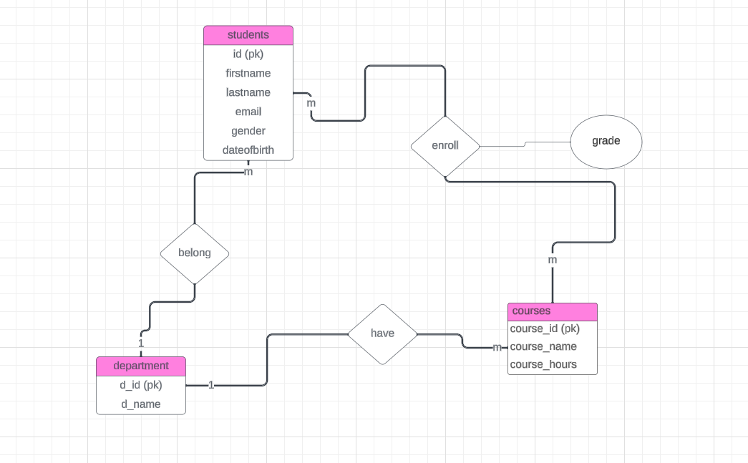
ER Diagram

Slide 8
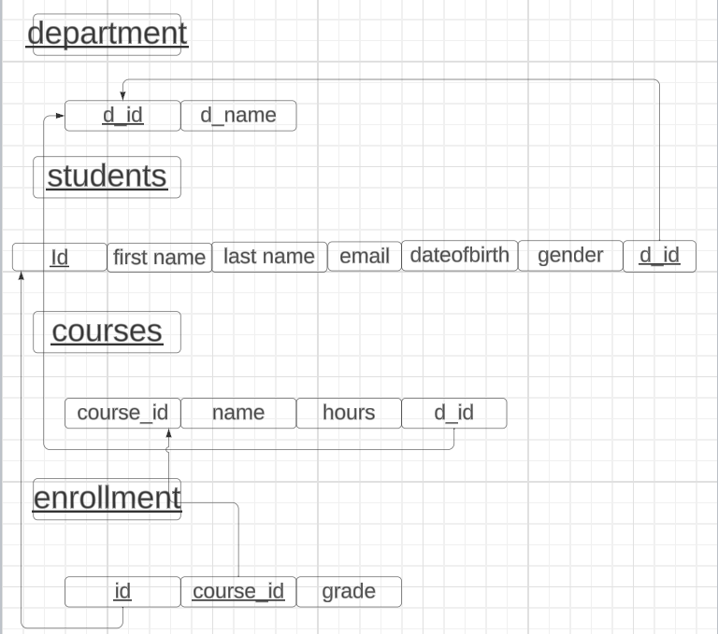
Schema

Slide 9
03
SQL Queries

Slide 10
SQL Queries
Create 4 tables : Students , Departments , Courses , Enrollment .
Insert data into 4 tables .
Retrieve all Students , all departments , all courses , all enrollment .
Retrieve all courses for each student .
Retrieve all courses for each department .
Retrieve all students that take a specific course .

Slide 11
04
PL/SQL Scripts

Slide 12
PL/SQL Scripts
Procedure :Update Grade for a Student in a specific course .
Trigger : Update Department Trigger .
A Trigger that removes courses not in the department when the department is updated for a student .
Procedure :Update department for student .
Procedure : Update Course for a student .
Procedure: Calculate and Update the gpa for all students.

Slide 13
05
Bash Scripts

Slide 14
Bash Scripts
Backup script .
utilizes the tar command to create a compressed backup archive.
Disk Space Monitoring .
check disk usage percentage against a predefined threshold.
sends an email alert if disk usage exceeds the specified threshold.
Check script .
Retrieves total and available physical memory information.
Calculates memory consumption percentage and send an alert if exceeds the threshold.

Slide 15
06
Challenges Faced

Slide 16
Challenges Faced
1)Department changes impacting enrollments
Description: Updating a student's department may cause complications with enrollments in courses not linked to the new department.
Solution: Addressed the challenge by implementing a trigger to automatically remove enrollments in courses not aligned with the updated department
2) Validating Course Department Compatibility
Description: The challenge involved ensuring that the selected new course for a student during departmental updates belonged to the updated department. Solution: an exception was implemented in the update_course procedure to ensures that only valid course updates within the same department are allowed.
3)Ensuring Uniqueness and Integrity with Sequence Trigger
Solution: Implemented a sequence trigger for primary key fields in all relevant tables. This ensures the generation of unique and sequential identifiers for each record insertion.

Slide 17
Do you have any questions?

Slide 18
THANKS

